Slide 1
3. Social Media Hyperlink Analytics
Amit Aylani

Slide 2
Contents
Social Media HyperLink Analytics -
Types of Hyperlinks,
Types of Hyperlink Analytics,
Hyperlink Analytics Tools

Slide 3
Hyperlinks
Hyperlinks are references to web resources that users can access by clicking on them.
They can link resources within a document (interlinking) or among documents (intralinking).
Hyperlinks can represent relationships such as trust, bonding, and authority between organizations.
They can also indicate content similarity between websites.
Hyperlinks serve as a symbolic means of communication and validation between organizations.

Slide 4
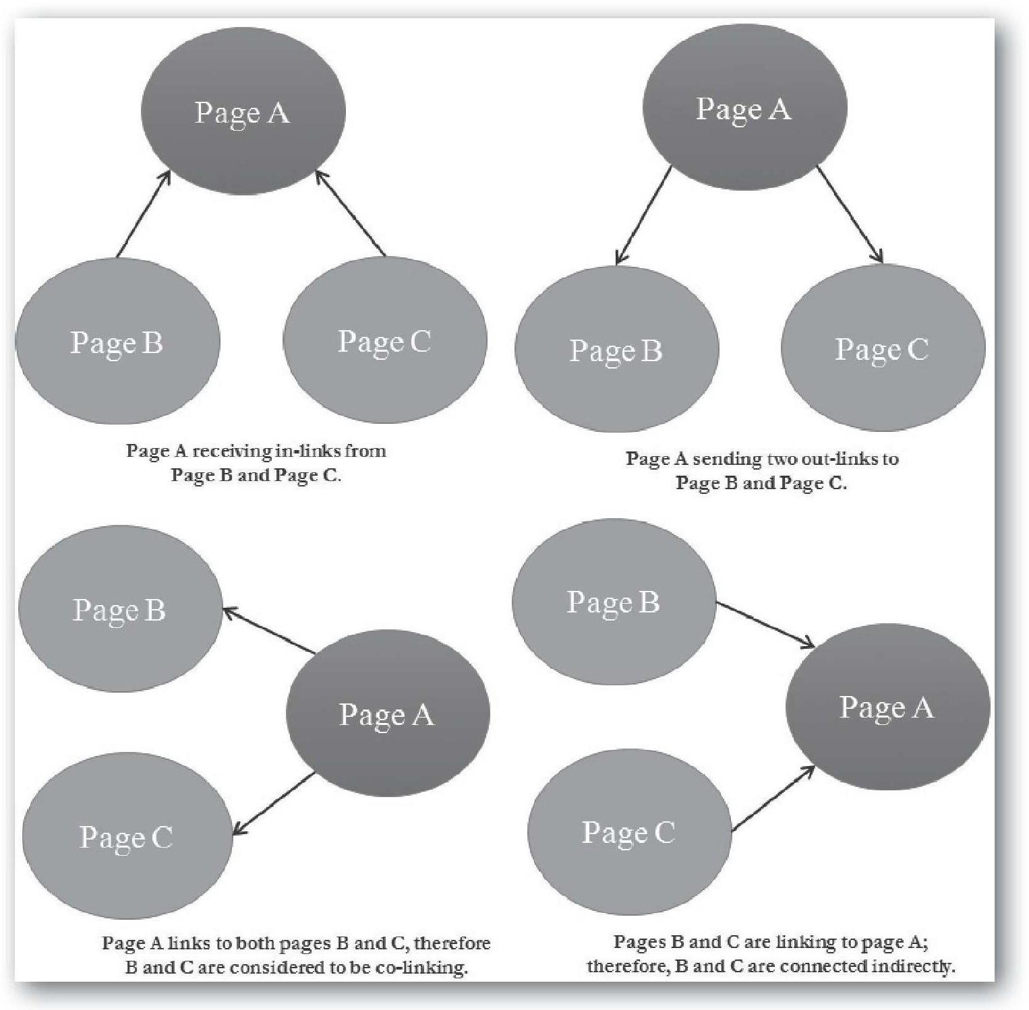
Types of Hyperlinks
IN-LINKS
OUT-LINKS
CO-LINKS

Slide 5
Types of Hyperlinks
IN-LINKS
In-links are the incoming hyperlinks or links directed toward a website or originated in other websites
OUT-LINKS
Out-links are hyperlinks generated out of a website
CO-LINKS
Co-links have two dimensions. First, if two websites receive a link from a third website, they are considered to be connected indirectly. For example, page A links to both pages B and C, therefore B and C are considered to be co-linking, or connected indirectly

Slide 6
Hyperlink Analytics
Hyperlink analytics involves extracting, analyzing, and interpreting hyperlinks.
The number and quality of hyperlinks to a website are believed to reflect its importance or value.
Hyperlink analytics can reveal Internet traffic patterns and sources of incoming or outgoing traffic to and from a website.
Hyperlink analysis has been used to study a variety of topics, including ranking universities, understanding the blogosphere, and measuring business competitiveness.
Hyperlink analysis has some limitations, including that it does not provide insight into the type or amount of traffic flowing among websites.
Hyperlinks within a website between pages are mostly for navigational purposes and are given low importance by search engine ranking algorithms.

Slide 7
Types of Hyperlink Analytics
1) Hyperlink environment analysis,
2) Link impact analysis, and
3) Social media hyperlink analysis.

Slide 8
Hyperlink environment analysis
Hyperlink environment analyses deal with a particular website or set of websites.
Hyperlinks (i.e., out-links, in-links, and co-links) of a website are extracted and analyzed to identify the sources of Internet traffic.
Hyperlinks environment networks can take two forms:
1) co-links networks or
2) in-links and out-links networks.

Slide 9
2) Co-Link Networks
Co-Link Networks
In co-links environment networks, nodes are websites and links that represent similarity between websites, as measured by co-link counts.
With the Webometric Analyst tool, one can construct a co-link network diagram among a set of websites .

Slide 10
3) In-Links and Out-Links Networks
In-links and out-links hyperlink environment networks are constructed based on in-links and out-links from a website or set of websites.
Nodes will be websites and links will present in-links and out-links

Slide 11
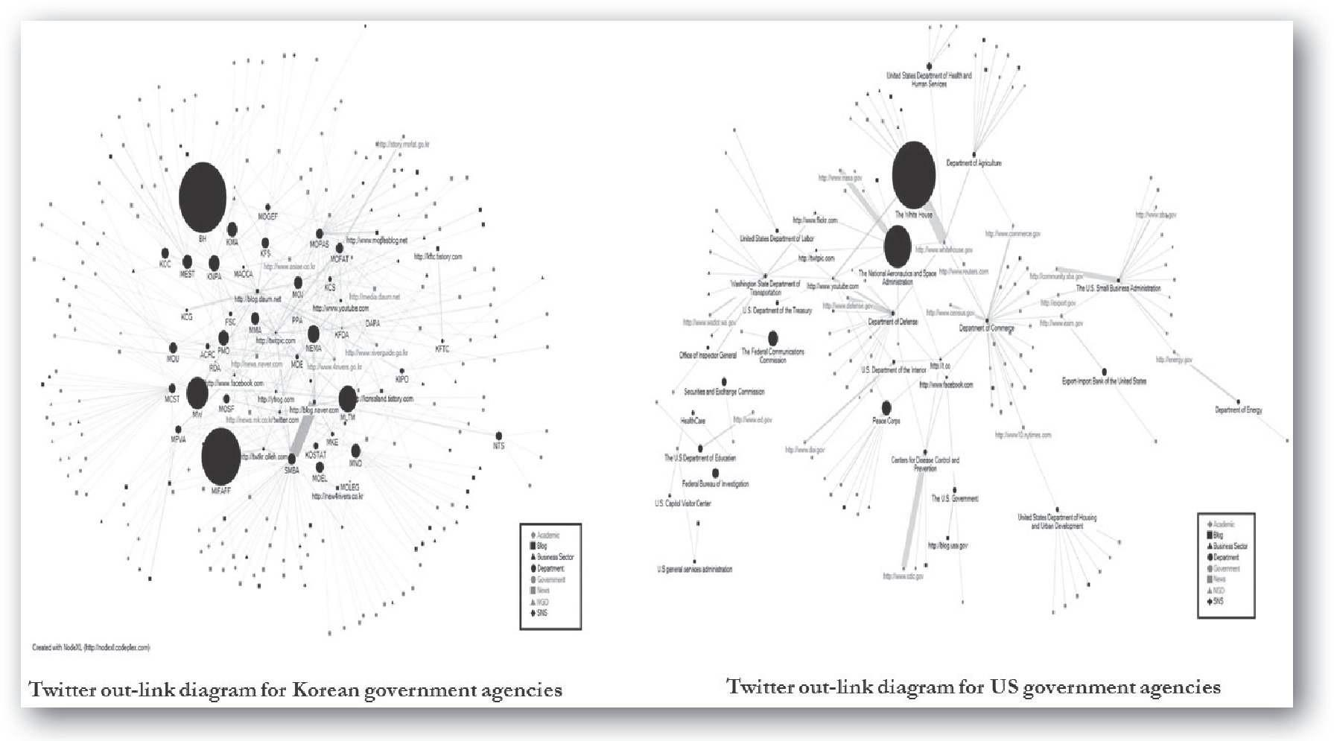
Social Media HyperLink Analytics

Slide 12
Social Media Hyperlink Analytics
Social media hyperlink analysis involves extracting and analyzing hyperlinks embedded in social media texts.
These hyperlinks can be used to identify the sources and destinations of social media traffic.
A study by Khan et al. found that the Korean government tended to cite domestic sources and self-cited more, while the US government had a more diverse pattern of out-link destinations.
These findings suggest that social media out-links can carry valuable information and help explain real-world phenomena and differences in social media use among different cultures.

Slide 13
HyperLink Impact Analysis
Link impact analysis investigates the impact of a website's URL in terms of citations or mentions it receives on the web.
Statistics about web pages that mention the URL of a given website are collected and analyzed.
It is assumed that a frequently cited URL is more important, so measuring the web impact of URLs can provide an idea about the importance of a website.

Slide 14
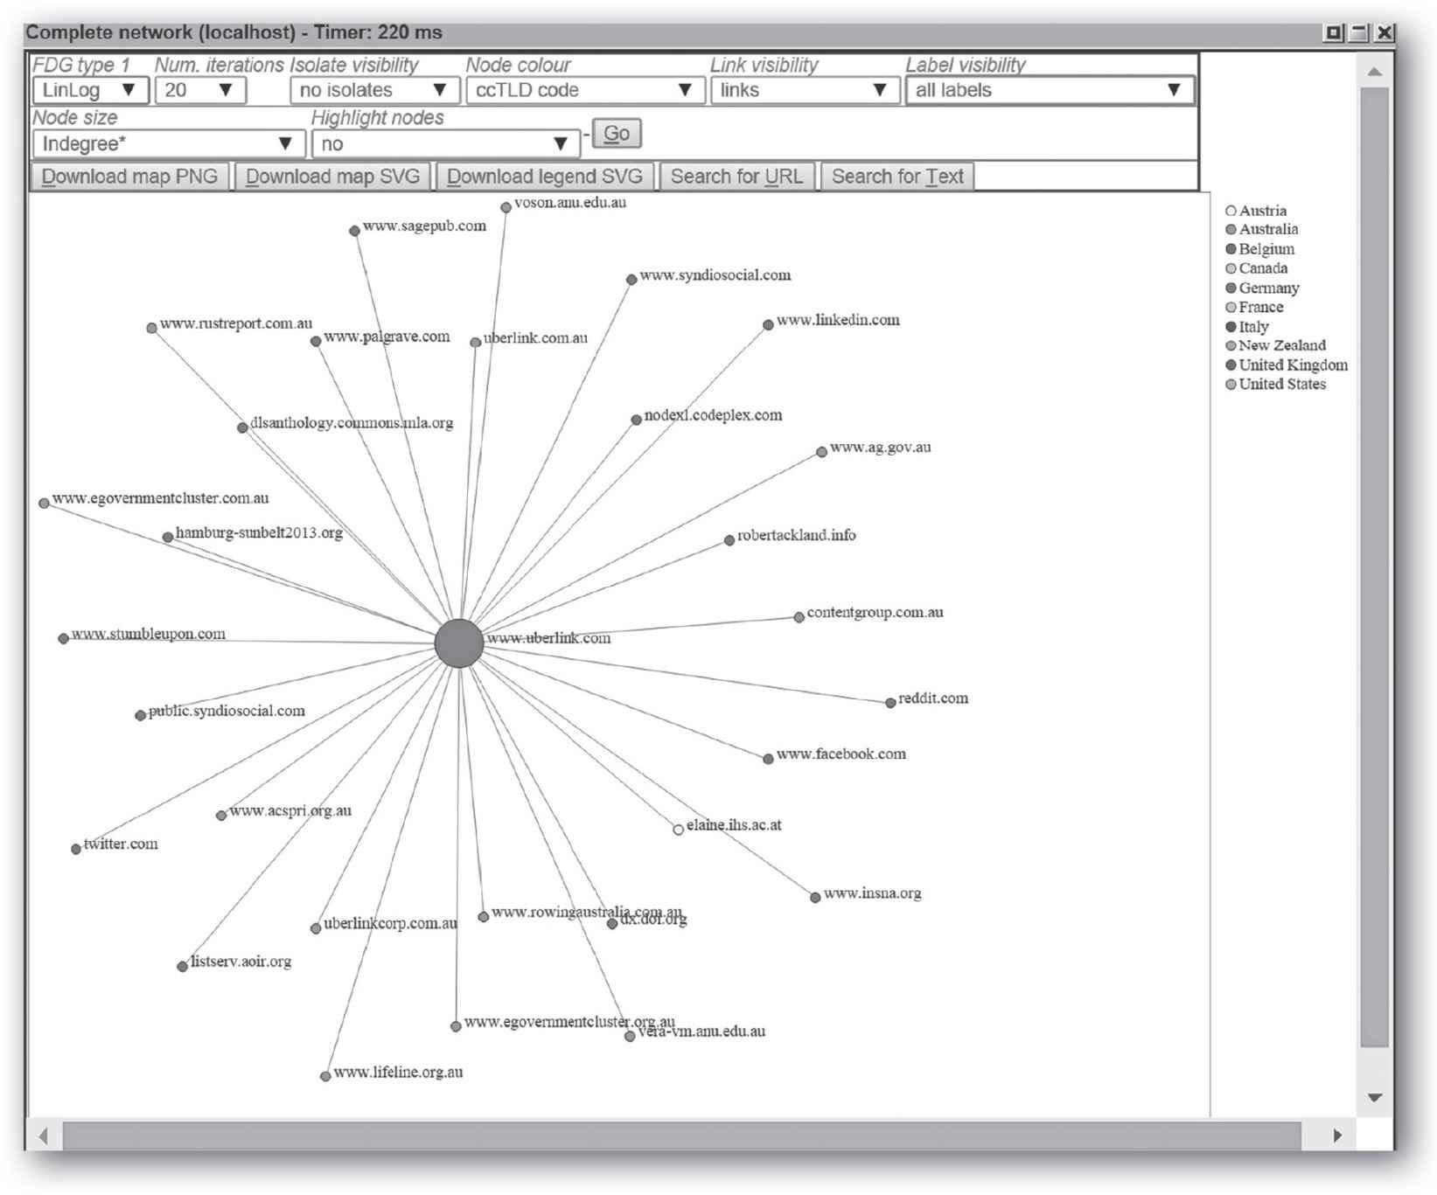
Hyperlink Analytics Tool
https://majestic.com/reports/site-explorer
Demo

Slide 15
Hyperlink Analytics Tool
https://vosonlab.github.io/

Slide 16
Questions
What are hyperlinks, and why they are important?
Briefly discuss in-links, out-links, and co-links.
What is hyperlink analytics and its underlying assumptions?
What is hyperlink environment analysis?
What is link impact analysis?
What is social media hyperlink analysis?

